Slide 1
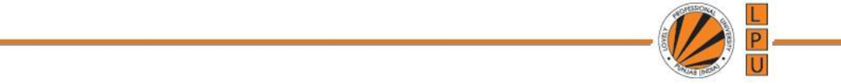
UNIT-V CURSORS (Part-V) Triggers

Slide 2
What are Triggers?
Triggers are stored programs, which are automatically executed or fired when some events occur.
Triggers are written to be executed in response to any of the following events −
A database manipulation (DML) statement (DELETE, INSERT, or UPDATE)
A database definition (DDL) statement (CREATE, ALTER, or DROP).
A database operation (SERVERERROR, LOGON, LOGOFF, STARTUP, or SHUTDOWN).

Slide 3
Benefits of Triggers
Generating some derived column values automatically
Enforcing referential integrity
Event logging and storing information on table access
Auditing
Synchronous replication of tables
Imposing security authorizations
Preventing invalid transactions

Slide 4
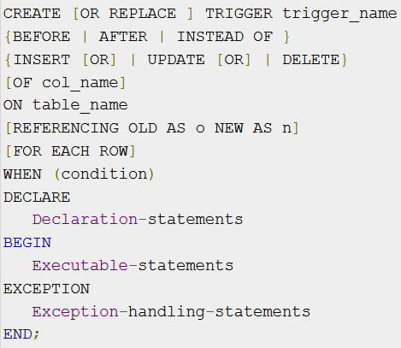
Creating Triggers

Slide 5
Creating Triggers
CREATE [OR REPLACE] TRIGGER trigger_name − Creates or replaces an existing trigger with the trigger_name.
{BEFORE | AFTER | INSTEAD OF} − Specifies when the trigger will be executed. The INSTEAD OF clause is used for creating trigger on a view.
{INSERT [OR] | UPDATE [OR] | DELETE} − Specifies the DML operation.
[OF col_name] − Specifies the column name that will be updated.
[ON table_name] − Table Name associated with the trigger.
[REFERENCING OLD AS o NEW AS n] − Allows you to refer new and old values for various DML statements, such as INSERT, UPDATE, and DELETE.
[FOR EACH ROW] − Specifies a row-level trigger, i.e., the trigger will be executed for each row being affected. Otherwise the trigger will execute just once when the SQL statement is executed, which is called a table level trigger.
WHEN (condition) − Condition for rows for which the trigger would fire. This clause is valid only for row-level triggers.

Slide 6
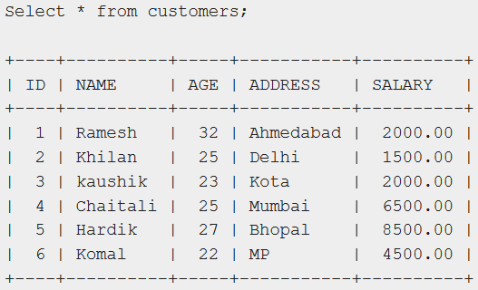
Example
Create a row-level trigger for the customers table that would fire for INSERT or UPDATE or DELETE operations performed on the CUSTOMERS table.
This trigger will display the salary difference between the old values and new values

Slide 7
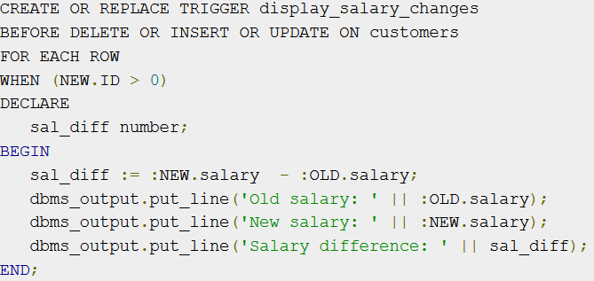
Example

Slide 8

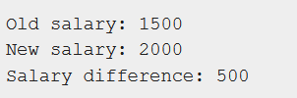
How to trigger a TRIGGER on table?
Above created trigger, display_salary_changes will be fired and it will display the following result :
Because this is a new record, old salary is not available and the above result comes as null. Let us now perform one more DML operation as:

